Slide 1
Week 5 Update
Team Dragonflies
February 7, 2019

Slide 2
 | User Info | Room Info | Date and Price
Expedia | Visitor_location_country_id, visitor_location_country_id, visitor_hist_adr_usd; Srch_destination_id, srch_length_of_stay, srch_booking_window, srch_adults_count , srch_children_count, srch_room_count, srch_saturday_night_bool, srch_query_affinity_score | Prop_country_id, prop_id, prop_starrating, prop_review_score, prop_location_score, prop_log_historical_price, price_usd, promotion_flag | date_time, prop_log_historical_price, price_usd
Airbnb | (No visitors information, has hosts’ data) | 'description', 'city', 'state', 'zipcode', 'market', 'smart_location', 'country_code', 'country', 'latitude', 'longitude', 'room_type', 'bathrooms', 'bedrooms', 'beds', 'bed_type', 'amenities', 'square_feet', 'number_of_reviews', 'review_scores_rating', 'review_scores_accuracy', 'review_scores_cleanliness', 'review_scores_checkin', 'review_scores_communication', 'review_scores_location', 'review_scores_value', 'is_business_travel_ready' | 'price', 'weekly_price', 'monthly_price', 'security_deposit', 'cleaning_fee', 'guests_included', 'extra_people', 'minimum_nights', 'maximum_nights', 'calendar_updated', 'has_availability', ‘date’, ‘available’, ‘price’

Slide 3
DATASET FEATURES--USER
Expedia dataset includes visitor information in terms of location, visitor historical ratings and historical purchased amount very sparse! ~300+ records
Expedia dataset also includes user search info including search location, length of stay, booking window, adults and children count, room count, whether stay through saturday night or not
Airbnb dataset has no visitors information, but has hosts’ data
Notes:
Srch_destination_id, srch_length_of_stay, srch_booking_window, srch_adults_count , srch_children_count, srch_room_count, srch_saturday_night_bool, srch_query_affinity_score

Slide 4
ROOM
Expedia and Airbnb both have country and review information
Expedia has location score which is better than the detail location information which is provided by Airbnb
Airbnb has more detail information about the room facilities

Slide 5
DATE AND PRICE
Both Expedia and airbnb provide date time data
Airbnb doesn’t provide the historical price data and price information is only provided for the available rooms
Expedia has historical price data and easier to check the date/price connection

Slide 6
Prediction rationale
No enough users information
Room features available
Date and price data available
Predict price based on room and date is more feasible

Slide 7
Literature review - methodology
1. Airbnb room rate prediction
KNN algorithm applied
Find a few listings that are similar to target
Average the listed price for the ones most similar to target
Set listing price of target to this calculated average price
Reference: Machine Learning Predicting Airbnb Prices
Based on property data
Notes:
More to see: https://www.dataquest.io/blog/machine-learning-tutorial/

Slide 8
2. collaborative filtering (CF) or content- based filtering (CBF)
Use Expedia search data to represent user data
combine collaborative filtering (CF) with content-based (CBF) method to overcome sparsity issue
Reference: Zhang, K., Wang, K., Wang, X., Jin, C., & Zhou, A. (2015). Hotel recommendation based on user preference analysis. 2015 31st IEEE International Conference on Data Engineering Workshops, 134-138.
Based on user and property data

Slide 9
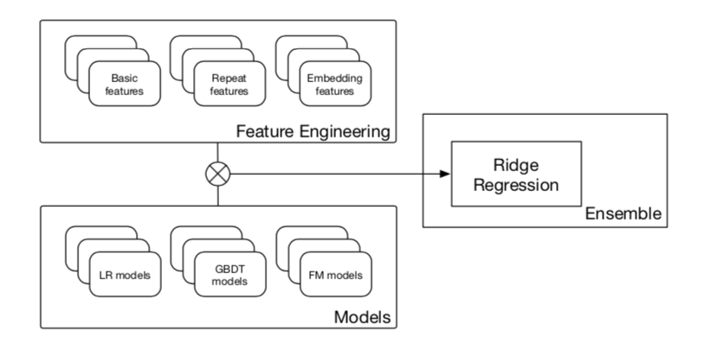
3. Predict linkages of “search” and “property”
Build graph between “search” and “hotel property”
Classify ‘Search - Property’ pair
Predict ‘Search - Property’ linkage
(*Expedia data already had “search” and “property” data)
Reference: Fang, Z., Yang, Z., & Zhang, Y. (2015). Collaborative Embedding Features and Diversified Ensemble for E-Commerce Repeat Buyer Prediction.
Based on user and property data
More like building a
“ Hotel Recommender System” :-)

Slide 10
4. Social popularity to predict hotel prices
Reference: Bollen, Johan et al. “Twitter mood predicts the stock market.” J. Comput. Science 2 (2011): 1-8.
Process: need to get social popularity data (one possible data source: Google popularity search)
Based on other data

